Slide 1
Code review

Slide 2
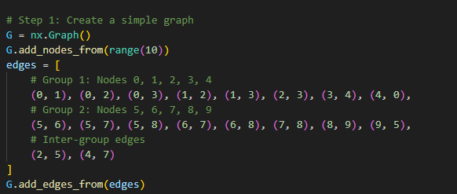
Deepwalk
1
2
6
0
7
4
5
3
8
9

Slide 3
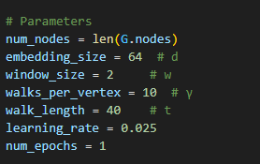
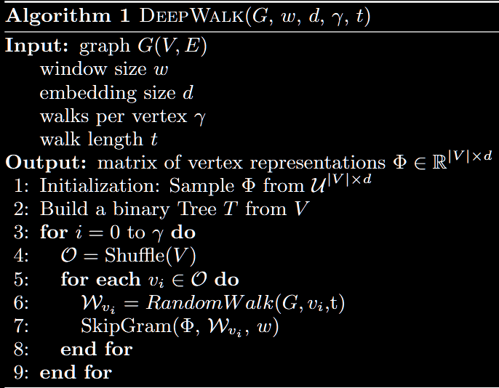
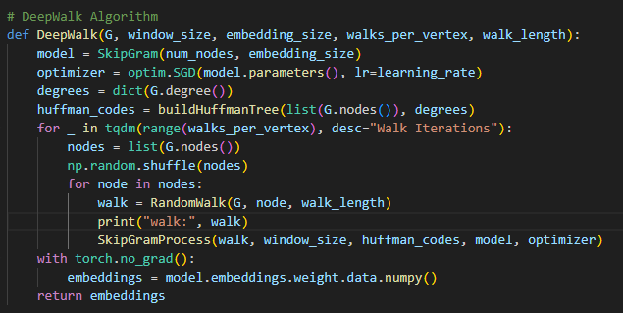
Deepwalk

Slide 4
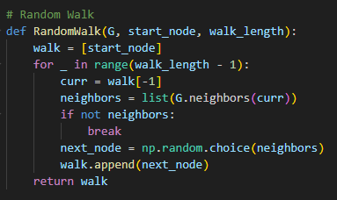
Deepwalk

Slide 5
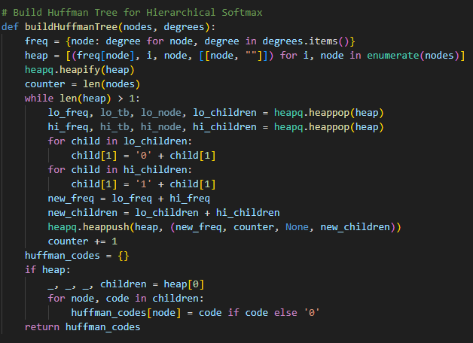
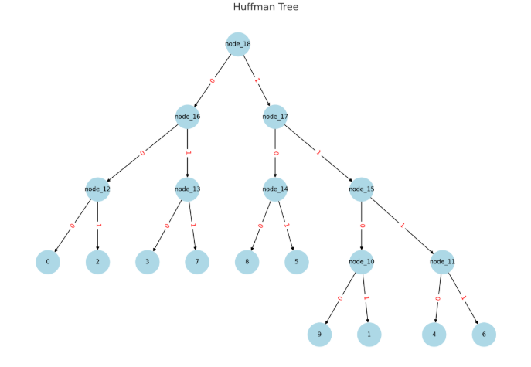
Deepwalk
heap = [
(4, 0, 0, [[0, ""]]), # Node 0: degree 4
(3, 1, 1, [[1, ""]]), # Node 1: degree 3
(4, 2, 2, [[2, ""]]), # Node 2: degree 4
(4, 3, 3, [[3, ""]]), # Node 3: degree 4
(3, 4, 4, [[4, ""]]), # Node 4: degree 3
(5, 5, 5, [[5, ""]]), # Node 5: degree 5
(3, 6, 6, [[6, ""]]), # Node 6: degree 3
(4, 7, 7, [[7, ""]]), # Node 7: degree 4
(4, 8, 8, [[8, ""]]), # Node 8: degree 4
(2, 9, 9, [[9, ""]]) # Node 9: degree 2
]
lo_freq, lo_tb, lo_node, lo_children: 2 9 9 [[9, '']]
hi_freq, hi_tb, hi_node, hi_children 3 1 1 [[1, '']]
heap: [
(3, 4, 4, [[4, '']]),
(4, 0, 0, [[0, '']]),
(3, 6, 6, [[6, '']]),
(4, 3, 3, [[3, '']]),
(4, 8, 8, [[8, '']]),
(5, 5, 5, [[5, '']]),
(4, 2, 2, [[2, '']]),
(4, 7, 7, [[7, '']]),
(5, 10, None, [[9, '0'], [1, '1']])]
lo_freq, lo_tb, lo_node, lo_children: 3 4 4 [[4, '']]
hi_freq, hi_tb, hi_node, hi_children 3 6 6 [[6, '']]
heap: [
(4, 0, 0, [[0, '']]),
(4, 3, 3, [[3, '']]),
(4, 2, 2, [[2, '']]),
(4, 7, 7, [[7, '']]),
(4, 8, 8, [[8, '']]),
(5, 5, 5, [[5, '']]),
(5, 10, None, [[9, '0'], [1, '1']]),
(6, 11, None, [[4, '0'], [6, '1']])]
lo_freq, lo_tb, lo_node, lo_children: 4 0 0 [[0, '']]
hi_freq, hi_tb, hi_node, hi_children 4 2 2 [[2, '']]
heap: [
(4, 3, 3, [[3, '']]),
(4, 7, 7, [[7, '']]),
(5, 5, 5, [[5, '']]),
(5, 10, None, [[9, '0'], [1, '1']]),
(4, 8, 8, [[8, '']]),
(6, 11, None, [[4, '0'], [6, '1']]),
(8, 12, None, [[0, '0'], [2, '1']])]
lo_freq, lo_tb, lo_node, lo_children: 4 3 3 [[3, '']]
hi_freq, hi_tb, hi_node, hi_children 4 7 7 [[7, '']]
heap: [
(4, 8, 8, [[8, '']]),
(5, 10, None, [[9, '0'], [1, '1']]),
(5, 5, 5, [[5, '']]),
(6, 11, None, [[4, '0'], [6, '1']]),
(8, 12, None, [[0, '0'], [2, '1']]),
(8, 13, None, [[3, '0'], [7, '1']])]
lo_freq, lo_tb, lo_node, lo_children: 4 8 8 [[8, '']]
hi_freq, hi_tb, hi_node, hi_children 5 5 5 [[5, '']]
heap: [
(5, 10, None, [[9, '0'], [1, '1']]),
(6, 11, None, [[4, '0'], [6, '1']]),
(8, 13, None, [[3, '0'], [7, '1']]),
(8, 12, None, [[0, '0'], [2, '1']]),
(9, 14, None, [[8, '0'], [5, '1']])]
lo_freq, lo_tb, lo_node, lo_children: 5 10 None [[9, '0'], [1, '1']]
hi_freq, hi_tb, hi_node, hi_children 6 11 None [[4, '0'], [6, '1']]
heap: [
(8, 12, None, [[0, '0'], [2, '1']]),
(9, 14, None, [[8, '0'], [5, '1']]),
(8, 13, None, [[3, '0'], [7, '1']]),
(11, 15, None, [[9, '00'], [1, '01'],
[4, '10'], [6, '11']])]
lo_freq, lo_tb, lo_node, lo_children: 8 12 None [[0, '0'], [2, '1']]
hi_freq, hi_tb, hi_node, hi_children 8 13 None [[3, '0'], [7, '1']]
heap: [
(9, 14, None, [[8, '0'], [5, '1']]),
(11, 15, None, [[9, '00'], [1, '01'], [4, '10'], [6, '11']]),
(16, 16, None, [[0, '00'], [2, '01'], [3, '10'], [7, '11']])]
lo_freq, lo_tb, lo_node, lo_children: 9 14 None [[8, '0'], [5, '1']]
hi_freq, hi_tb, hi_node, hi_children 11 15 None [[9, '00'], [1, '01'], [4, '10'], [6, '11']]
heap: [
(16, 16, None, [[0, '00'], [2, '01'], [3, '10'], [7, '11']]),
(20, 17, None, [[8, '00'], [5, '01'], [9, '100'], [1, '101'], [4, '110'], [6, '111']])]
lo_freq, lo_tb, lo_node, lo_children: 16 16 None [[0, '00'], [2, '01'], [3, '10'], [7, '11']]
hi_freq, hi_tb, hi_node, hi_children 20 17 None [[8, '00'], [5, '01'], [9, '100'], [1, '101'], [4, '110'], [6, '111']]
heap: [(36, 18, None, [[0, '000'], [2, '001'], [3, '010'], [7, '011'], [8, '100'], [5, '101'], [9, '1100'], [1, '1101'], [4, '1110'], [6, '1111']])]

Slide 6
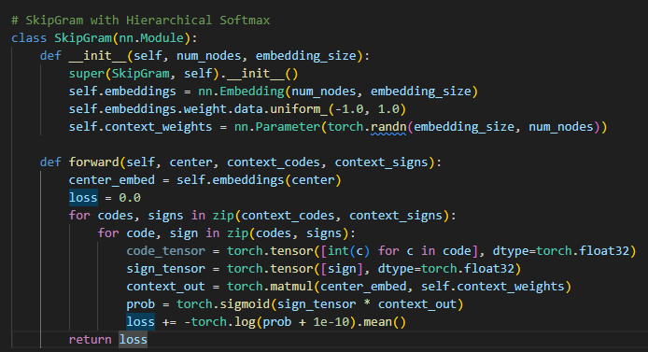
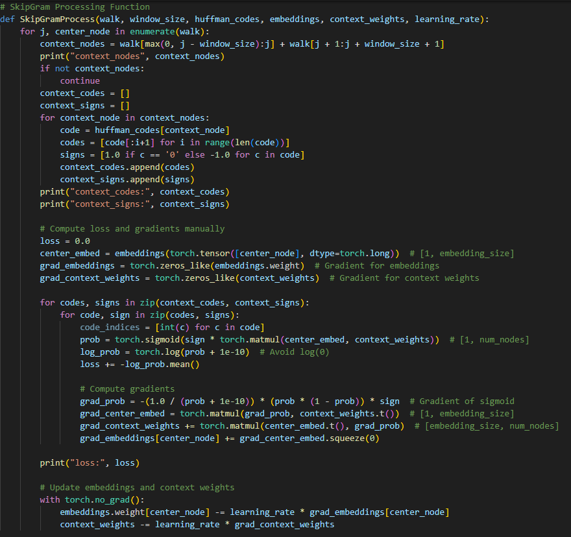
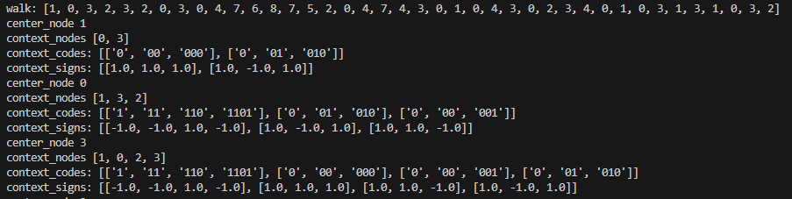
Deepwalk

Slide 7
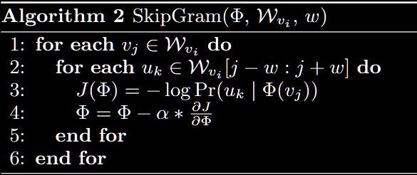
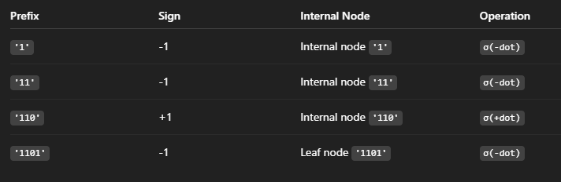
Deepwalk
compute the probability P(context | center_node) during training.
For each: - center_node: the input node - context_node: one of the surrounding nodes => decode the context_node using its Huffman code. ex: code = '010' context_codes = ['0', '01', '010'] context_signs = [+1.0, -1.0, +1.0] This means: - Step 1: go left (sign = +1) - Step 2: go right (sign = -1) - Step 3: go left (sign = +1)
How is P(context | center) computed? For each step i in context_codes: 1. Find the internal node in the Huffman tree for that prefix path. 2. Compute the dot product between the center_node embedding and the internal node’s vector. 3. Multiply the result by the sign (+1 for left, -1 for right). 4. Apply sigmoid to this value. z = dot(center_embedding, internal_node_vector) s = sign[i] * z p = sigmoid(s) If sign = +1, we want a high score → go left If sign = -1, we want a low score → go right
P(context | center) = Π sigmoid(sign[i] * dot(center, internal_node[i])) loss = -∑ log(sigmoid(sign[i] * dot(center, internal_node[i]))) Do this for each context node, and sum them for total loss
center_node = 3
context_node = 1 → Huffman code: '1101' → context_codes = ['1', '11', '110', '1101'] → context_signs = [-1, -1, +1, -1]
loss = -log(σ(-dot1)) - log(σ(-dot2)) - log(σ(+dot3)) - log(σ(-dot4))

Slide 8
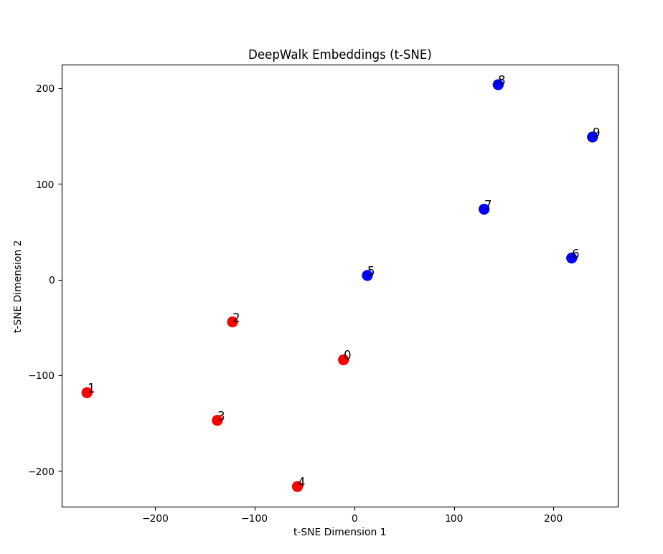
Deepwalk

Slide 9
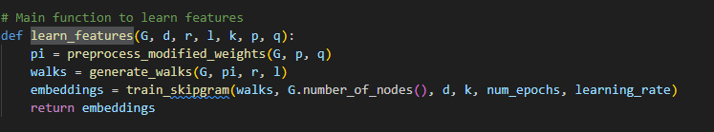
Node2vec
Algorithm Workflow
Step 1: Preprocess Transition Probabilities - Compute shortest paths using NetworkX. - Calculate transition probabilities (π) using p and q for biased walks.
Step 2: Generate Random Walks - Use Alias Sampling for efficient node selection. - Generate r * |V| walks of length l per node.
Step 3: Train Skip-gram Model - Input: Node-context pairs from walks. - Optimize using SGD and CrossEntropyLoss. - Output: 64-dimensional node embeddings.

Slide 10
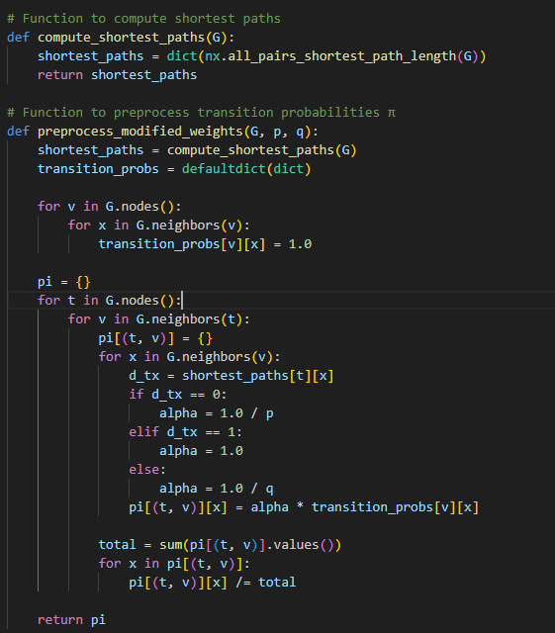
Node2vec
Step 1: Preprocess Transition Probabilities Input: Graph G, return parameter p, in-out parameter q.
Compute shortest path distances (d_tx) between nodes.
Assign weights (α) based on d_tx:
d_tx = 0 (return to previous): α = 1/p
d_tx = 1 (direct neighbor): α = 1
d_tx > 1 (farther nodes): α = 1/q
Normalize probabilities for each (t, v) pair.
Output: Dictionary pi[(t, v)][x] for biased walk probabilities.
Role: Enables structured random walks for embedding learning.

Slide 11
Node2vec
shortest_paths: {0: {0: 0, 1: 1, 2: 1, 3: 1, 4: 1, 5: 2, 7: 2, 6: 3, 8: 3, 9: 3}, 1: {1: 0, 0: 1, 2: 1, 3: 1, 4: 2, 5: 2, 7: 3, 6: 3, 8: 3, 9: 3}, 2: {2: 0, 0: 1, 1: 1, 3: 1, 5: 1, 4: 2, 6: 2, 7: 2, 8: 2, 9: 2}, 3: {3: 0, 0: 1, 1: 1, 2: 1, 4: 1, 5: 2, 7: 2, 6: 3, 8: 3, 9: 3}, 4: {4: 0, 3: 1, 0: 1, 7: 1, 1: 2, 2: 2, 5: 2, 6: 2, 8: 2, 9: 3}, 5: {5: 0, 6: 1, 7: 1, 8: 1, 9: 1, 2: 1, 4: 2, 0: 2, 1: 2, 3: 2}, 6: {6: 0, 5: 1, 7: 1, 8: 1, 9: 2, 2: 2, 4: 2, 0: 3, 1: 3, 3: 3}, 7: {7: 0, 5: 1, 6: 1, 8: 1, 4: 1, 9: 2, 2: 2, 3: 2, 0: 2, 1: 3}, 8: {8: 0, 5: 1, 6: 1, 7: 1, 9: 1, 2: 2, 4: 2, 0: 3, 1: 3, 3: 3}, 9: {9: 0, 8: 1, 5: 1, 6: 2, 7: 2, 2: 2, 4: 3, 0: 3, 1: 3, 3: 3}}
shortest_paths[0] = {0: 0, 1: 1, 2: 1, 3: 1, 4: 1, 5: 2, 7: 2, 6: 3, 8: 3, 9: 3} Distance 0: 0 (self). Distance 1: 1, 2, 3, 4 ). Distance 2: 5, 7 Distance 3: 6, 8, 9
1
2
6
0
7
4
pi {(0, 1): {0: 0.3333333333333333, 2: 0.3333333333333333, 3: 0.3333333333333333}, (0, 2): {0: 0.25, 1: 0.25, 3: 0.25, 5: 0.25}, (0, 3): {0: 0.25, 1: 0.25, 2: 0.25, 4: 0.25}, (0, 4): {3: 0.3333333333333333, 0: 0.3333333333333333, 7: 0.3333333333333333}, (1, 0): {1: 0.25, 2: 0.25, 3: 0.25, 4: 0.25}, (1, 2): {0: 0.25, 1: 0.25, 3: 0.25, 5: 0.25}, (1, 3): {0: 0.25, 1: 0.25, 2: 0.25, 4: 0.25}, (2, 0): {1: 0.25, 2: 0.25, 3: 0.25, 4: 0.25}, (2, 1): {0: 0.3333333333333333, 2: 0.3333333333333333, 3: 0.3333333333333333}, (2, 3): {0: 0.25, 1: 0.25, 2: 0.25, 4: 0.25}, (2, 5): {6: 0.2, 7: 0.2, 8: 0.2, 9: 0.2, 2: 0.2}, (3, 0): {1: 0.25, 2: 0.25, 3: 0.25, 4: 0.25}, (3, 1): {0: 0.3333333333333333, 2: 0.3333333333333333, 3: 0.3333333333333333}, (3, 2): {0: 0.25, 1: 0.25, 3: 0.25, 5: 0.25}, (3, 4): {3: 0.3333333333333333, 0: 0.3333333333333333, 7: 0.3333333333333333}, (4, 3): {0: 0.25, 1: 0.25, 2: 0.25, 4: 0.25}, (4, 0): {1: 0.25, 2: 0.25, 3: 0.25, 4: 0.25}, (4, 7): {5: 0.25, 6: 0.25, 8: 0.25, 4: 0.25}, (5, 6): {5: 0.3333333333333333, 7: 0.3333333333333333, 8: 0.3333333333333333}, (5, 7): {5: 0.25, 6: 0.25, 8: 0.25, 4: 0.25}, (5, 8): {5: 0.25, 6: 0.25, 7: 0.25, 9: 0.25}, (5, 9): {8: 0.5, 5: 0.5}, (5, 2): {0: 0.25, 1: 0.25, 3: 0.25, 5: 0.25}, (6, 5): {6: 0.2, 7: 0.2, 8: 0.2, 9: 0.2, 2: 0.2}, (6, 7): {5: 0.25, 6: 0.25, 8: 0.25, 4: 0.25}, (6, 8): {5: 0.25, 6: 0.25, 7: 0.25, 9: 0.25}, (7, 5): {6: 0.2, 7: 0.2, 8: 0.2, 9: 0.2, 2: 0.2}, (7, 6): {5: 0.3333333333333333, 7: 0.3333333333333333, 8: 0.3333333333333333}, (7, 8): {5: 0.25, 6: 0.25, 7: 0.25, 9: 0.25}, (7, 4): {3: 0.3333333333333333, 0: 0.3333333333333333, 7: 0.3333333333333333}, (8, 5): {6: 0.2, 7: 0.2, 8: 0.2, 9: 0.2, 2: 0.2}, (8, 6): {5: 0.3333333333333333, 7: 0.3333333333333333, 8: 0.3333333333333333}, (8, 7): {5: 0.25, 6: 0.25, 8: 0.25, 4: 0.25}, (8, 9): {8: 0.5, 5: 0.5}, (9, 8): {5: 0.25, 6: 0.25, 7: 0.25, 9: 0.25}, (9, 5): {6: 0.2, 7: 0.2, 8: 0.2, 9: 0.2, 2: 0.2}}
5
3
8
9

